Slide 1
Spotify Pop Music Analytics and
Context-based Recommendation System
Team members:
Ruolin Hao, Mu Ding, Zhiang Zhang

Slide 2
Table of contents
01
02
03
Introduction
Related Work
Data
04
05
06
Methods
Demo
Future Work

Slide 3

Introduction
Music streaming services
Multiple choices
Music recommendation system

Slide 4


Introduction
Music recommendations system: content-based music recommendation, context based music recommendation, collaborative filtering and hybrid methods, and sequential music recommendation.
Our goal: conduct pop music analytics with Spotify & create a personalized context based playlist for users

Slide 5
Related Works
Content-based
Data format: audio, metadata, external sources
Bayesian classifier, cluster analysis to determine feature importance
Deep learning methods
Collaborative filtering
Explicit and implicit method
K means method to find similarity between users

Slide 6
Related Work
Context based
“information describing where you are, whom you are with, and what resources are nearby”
Environment-related context
Location, time, weather, temperature, etc.
User related context
Activity, emotional state, social environment

Slide 7
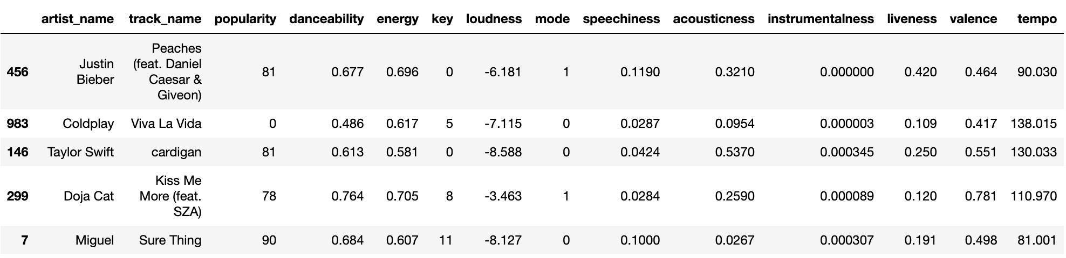
Data
Accessed via Spotify Web API with a lightweight Python library called Spotipy
Collected 24,000 instances of tracks released from 2000 to 2023
Each track instance contains 24 columns

Slide 8
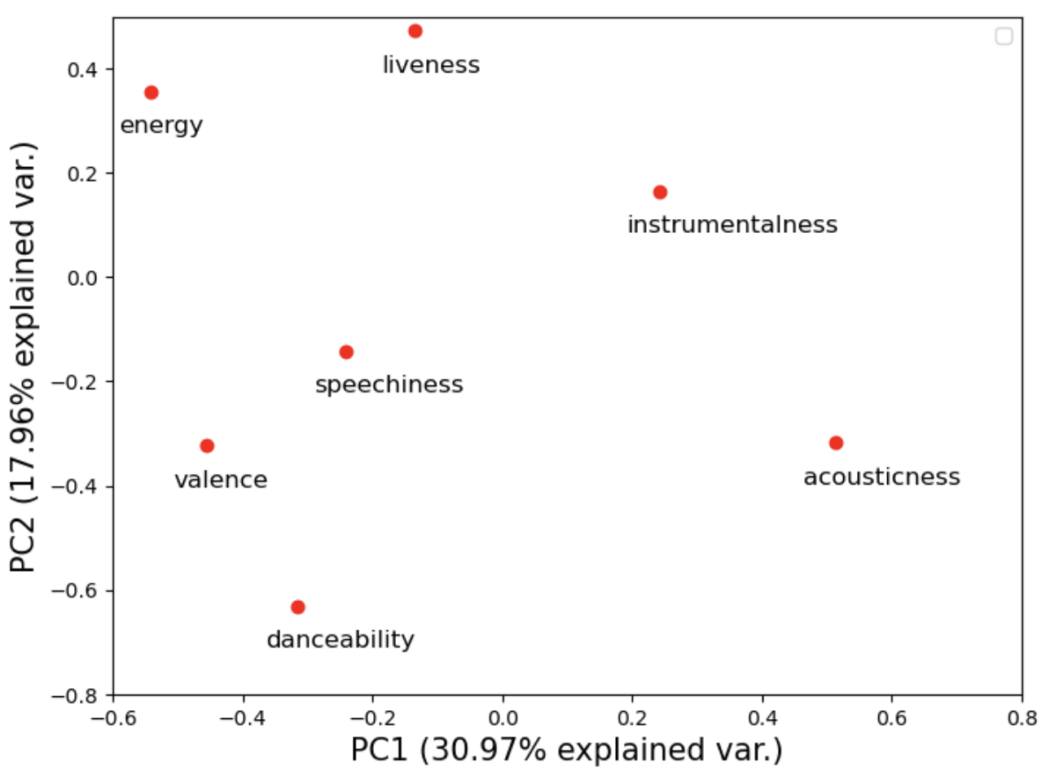
PCA
Tracks that are highly influenced by energy and acoustic features are separated from the remaining tracks by PC1
PC1 and PC2 can distinguish the tracks with high or low danceability
Prioritize these features in labeling

Slide 9
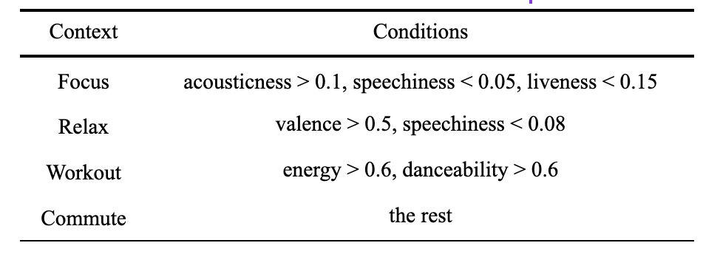
Methods - Labeling
Assign context labels to each song based on their acoustic characteristics
We defined each of the context as follows:

Slide 10
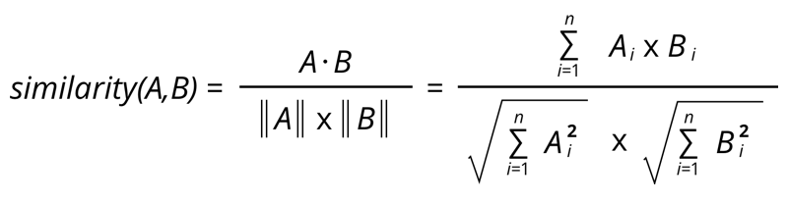
Methods - Cosine Similarity
Used cosine similarity to compute the similarity between pairs of songs
The cosine similarity ranges from 0 (no similarity) to 1 (perfect similarity)

Slide 11

Demo - Streamlit App
https://catherine-hao-si699-music-analytics-xw280c.streamlit.app/

Slide 12
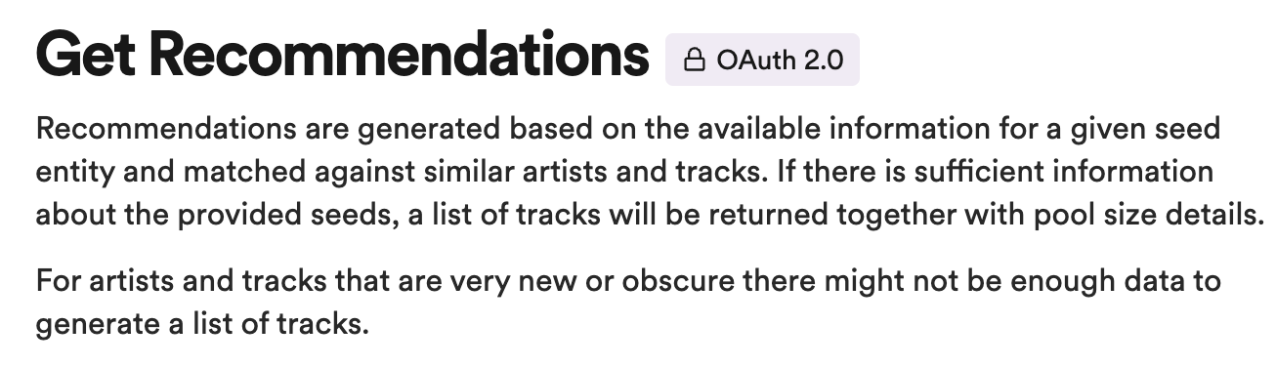
Future Work
Evaluation
Other algorithms
Collaborative filtering
Spotify’s built-in “Get Recommendations”

Slide 13
Thanks!

